Slide 1
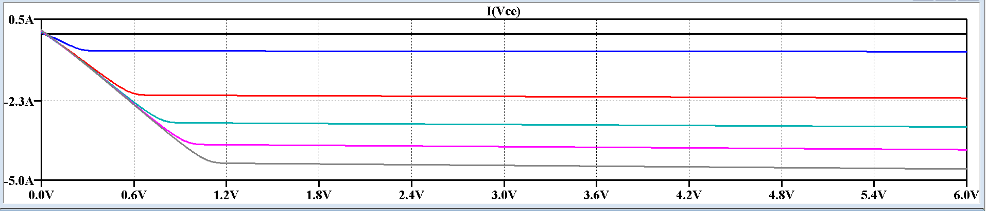
PART iii)
Vbe=1
Vbe=2
Vbe=3
Vbe=4
Vbe=5

Slide 2
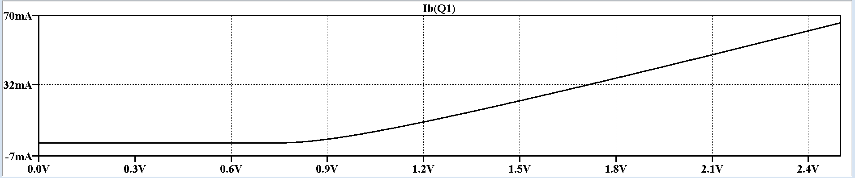
Part i)

Slide 3
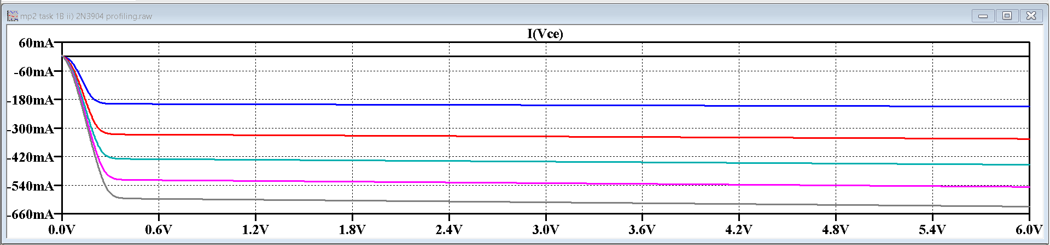
Part ii)
IB=1mA
IB=2mA
IB=3mA
IB=4mA
IB=5mA

Slide 4
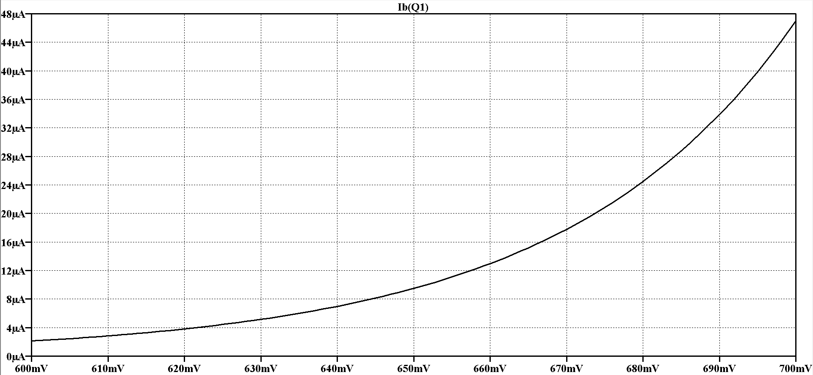
Part 1bi)

Slide 5
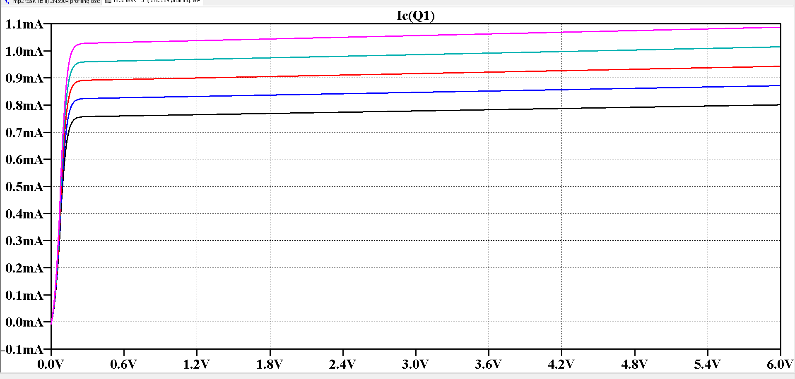
Part 1 bii)
ib=7ma
ib=7.5ma
ib=8ma
ib=8.5ma
ib=9ma

Slide 6
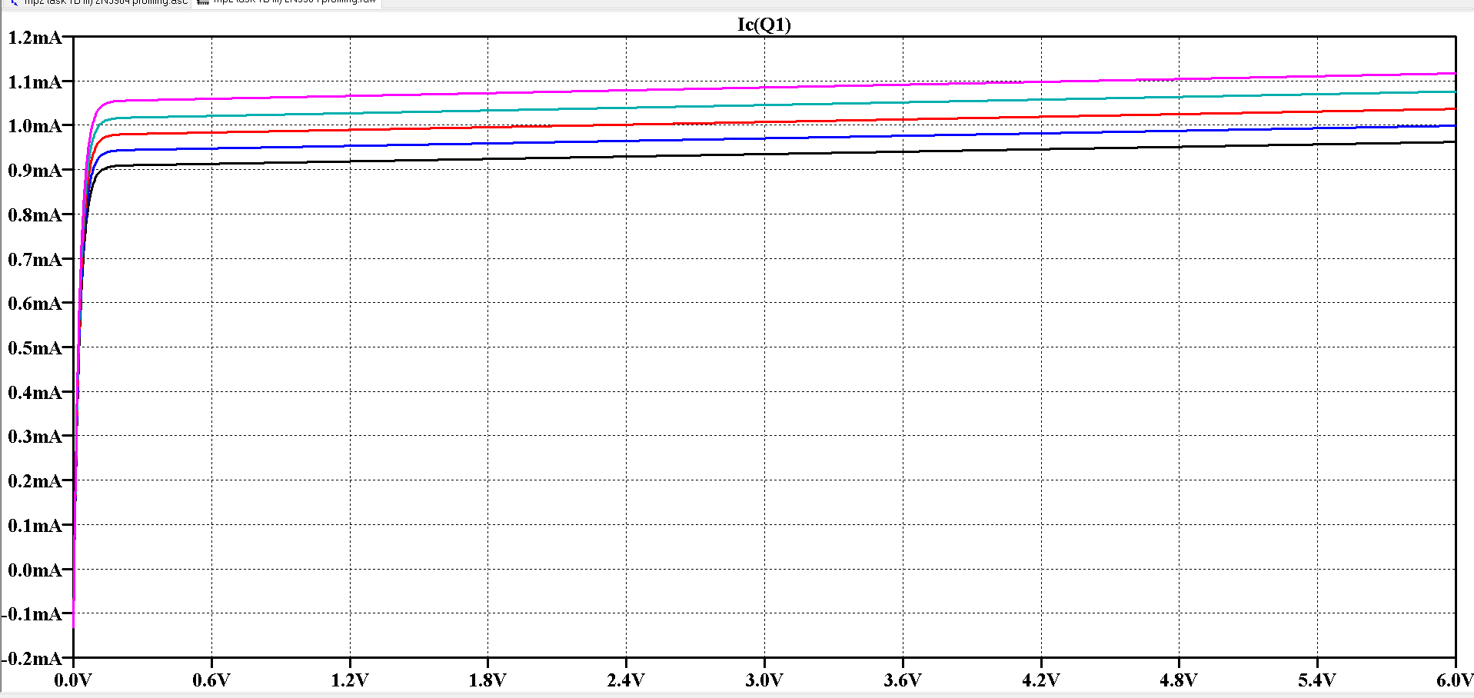
Part 1 b iii)
vbe=645mV
vbe=646mV
vbe=647mV
vbe=648mV
vbe=649mV

Slide 7
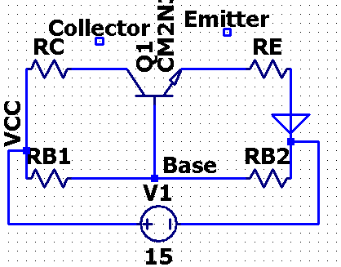
Part 1 c i)
ic
ie
ib
i1
i2

Slide 9
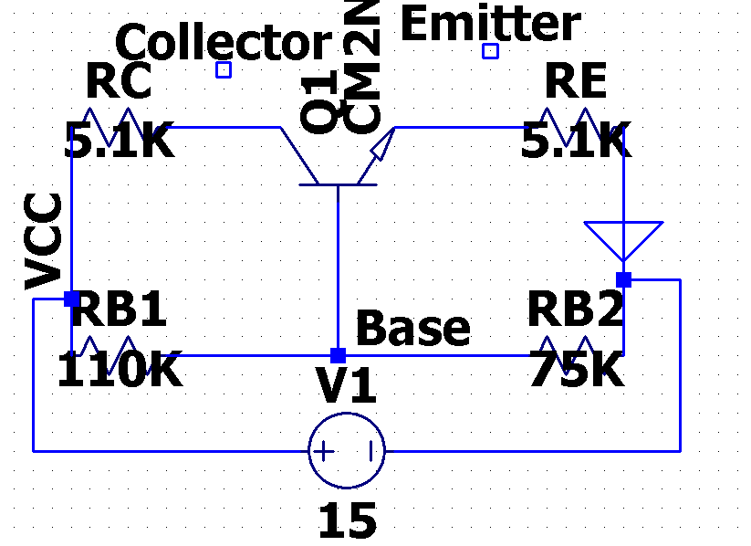
Part 1 c iii)

Slide 10
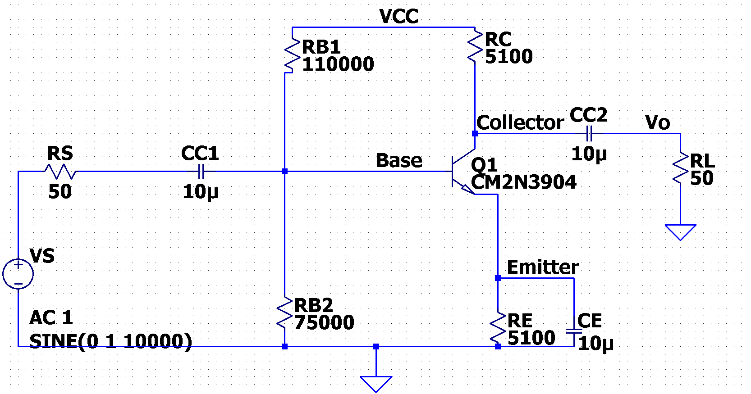
Part 2 a diagram 3904

Slide 11
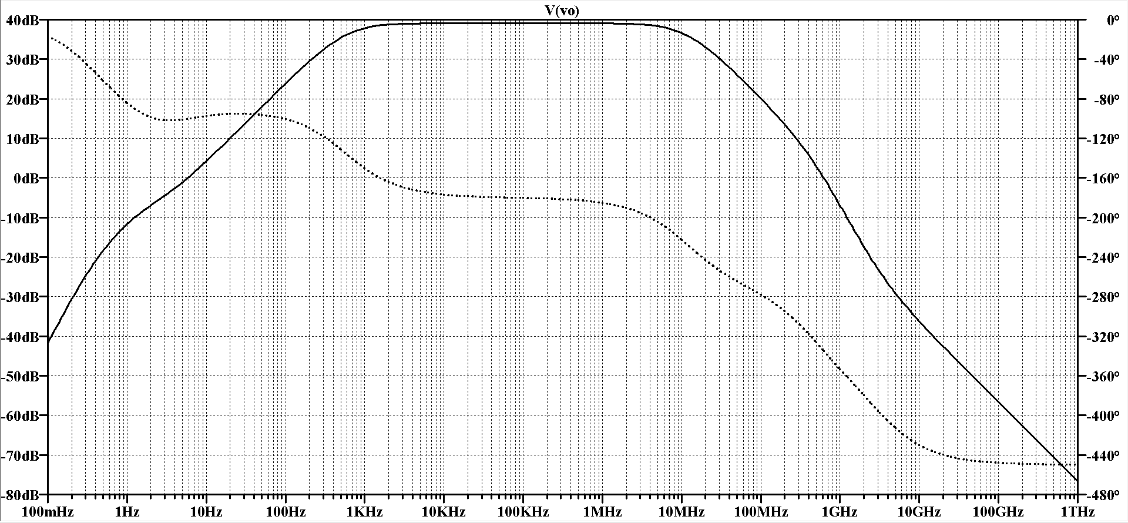
Part 2 a bode plot 3904

Slide 12
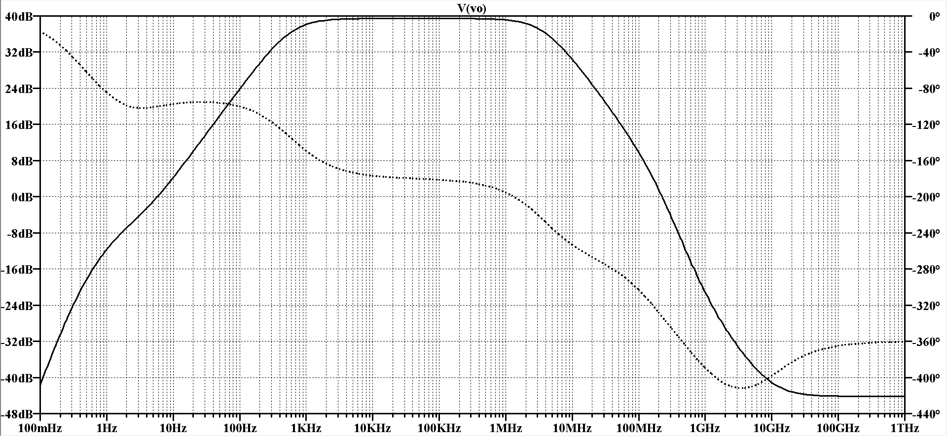
Part 2 a bode plot 4401

Slide 13
